Slide 1
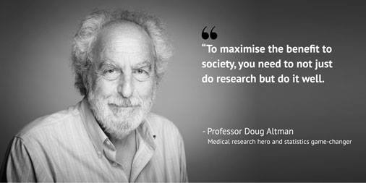
Understanding Lack
of Validity: Bias

Slide 2
Associations may be due to
Chance (random error)
statistics are used to reduce it by appropriate design of the study
statistics are used to estimate the probability that the observed results are due to chance
Bias (Systematic error)
must be considered in the design of the study
Confounding
can be dealt with during both the design and the analysis of the study
Causation

Slide 3
Dealing with chance error
During design of study
Sample size
Power
During analysis (Statistical measures of chance)
Test of statistical significance (P value)
Confidence intervals

Slide 4
Statistical measures of chance I (Test of statistical significance)
Actual Truth of H₀
Decision
H₀ is true
H₀ is false
Do not reject H₀
Correct Decision
Type II Error
Reject H₀
Type I Error
Correct Decision

Slide 5
P-value
the probability the observed results occurred by chance
statistically non-significant results are not necessarily attributable to chance due to small sample size

Slide 6
Statistical Power
Power = 1 – type II error
Power = 1

Slide 7
P value
0.00001
Clinical Importance
VS
Statistical Significance

Slide 8
Question?
20 out of 100 participants: 20%
200 out of 1000 participants: 20%
2000 out of 10000 participants: 20%
What is the difference?

Slide 9
Answer: Confidence Interval
Definition: A range of values for a variable of interest constructed so that this range has a specified probability of including the true value of the variable for the population
Characteristics:
a measure of the precision (stability) of an observed effect
the range within which the true magnitude of effect lies with a particular degree of certainty
95% C.I. means that true estimate of effect (mean, risk, rate) lies within 2 standard errors of the population mean 95 times out of 100
Confidence intervals get smaller (i.e. more precise or more certain) if the underlying data have less variation/scatter
Confidence intervals get smaller if there are more people in your sample

Slide 10
95% Confidence Interval (95% CI)
20 out of 100 participants: 20%
95% CI: 12 to 28
80 out of 400 participants: 20%
95% CI: 16 to 24
2000 out of 10000 participants: 20%
95% CI: 19.2 to 20.8

Slide 11
Associations may be due to
Chance (random error)
statistics are used to reduce it by appropriate design of the study
statistics are used to estimate the probability that the observed results are due to chance
Bias (Systematic error)
must be considered in the design of the study
Confounding
can be dealt with during both the design and the analysis of the study
Causation

Slide 12
Bias
Any systematic error that results in an incorrect estimate of the association between risk factors and outcome
A systematic error in the design or conduct of a study.
The definition of bias relates to the process—that is, the design and procedures—and not the results of any particular study.

Slide 13
BIAS: threats to validity and interpretation
Systematic error results from flaws in either the (1) method of selection of study participants, or
(2) in the procedures for gathering relevant exposure and/or disease information
Hence - the observed study results will tend to be different from the true results

Slide 14
Bias results from systematic flaws
Study design,
Data collection,
Analysis
Interpretation of results

Slide 15
Bias
A faulty study design is considered to be biased (or invalid) because it will produce an erroneous result on average
A biased study can produce a result close to the truth when combined with sampling error
Conversely, an unbiased study can produce results that are substantially different from
the truth because of random sampling variability.

Slide 16
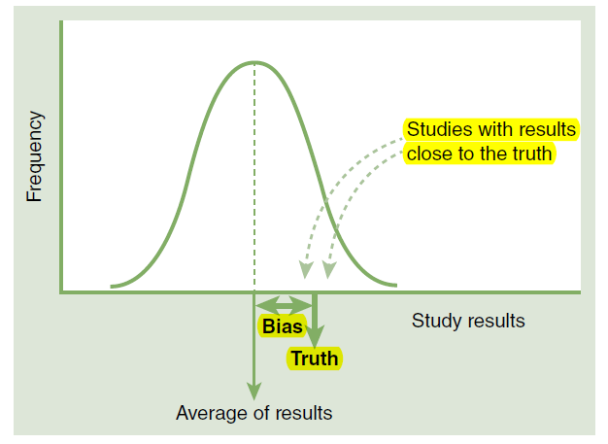
Bias is said to exist when, on average, the results of a hypothetically infinite number of studies
(related to a specific association and reference population) differ from the true result

Slide 17
Prevention and control of bias are accomplished on three levels
ensuring that the study design—including the procedures for selection of the study sample—is appropriate for addressing the study hypotheses.
establishing and carefully monitoring procedures of data collection that are valid and reliable.
using appropriate analytic procedures.

Slide 18
Types of Bias
Selection bias – identification of individual subjects for inclusion in study on the basis of either exposure or disease status depends in some way on the other axis of interest
Iinformation bias – results from systematic differences in the way data on exposure or outcome are obtained from the various study groups

Slide 19
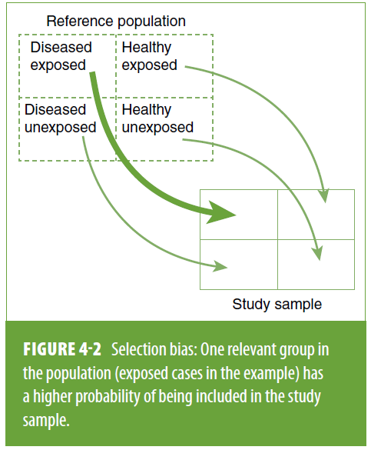
Selection bias
is present when individuals have different probabilities of being included in the study sample according to relevant study characteristics-namely, the exposure and the outcome of interest.

Slide 20
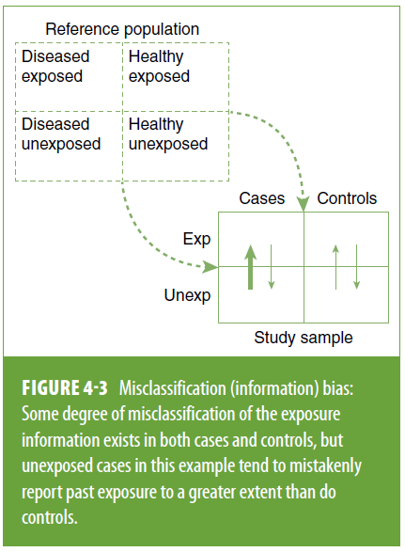
Information bias
results from a systematic tendency for individuals selected for inclusion in the study to be erroneously placed in different exposure/outcome categories, thus leading to misclassification.

Slide 21
Selection Bias
Selection bias occurs when a systematic error in the ascertainment of study subjects (cases or controls in case-control studies, or exposed or unexposed subjects in cohort studies) results in a tendency toward distorting the measure expressing the association between exposure and outcome. (Berksonian bias)

Slide 22
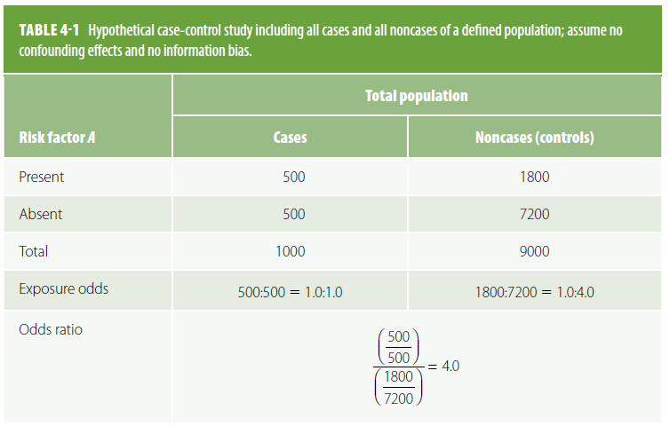

Slide 23
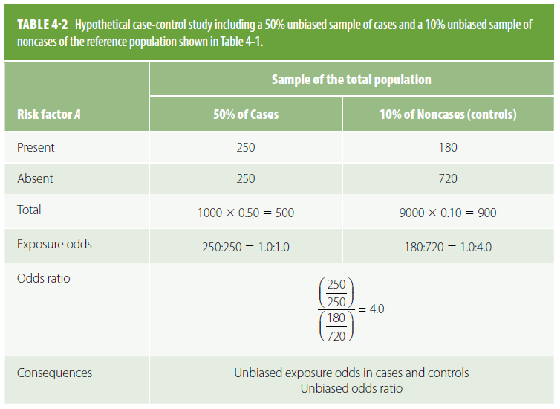

Slide 24
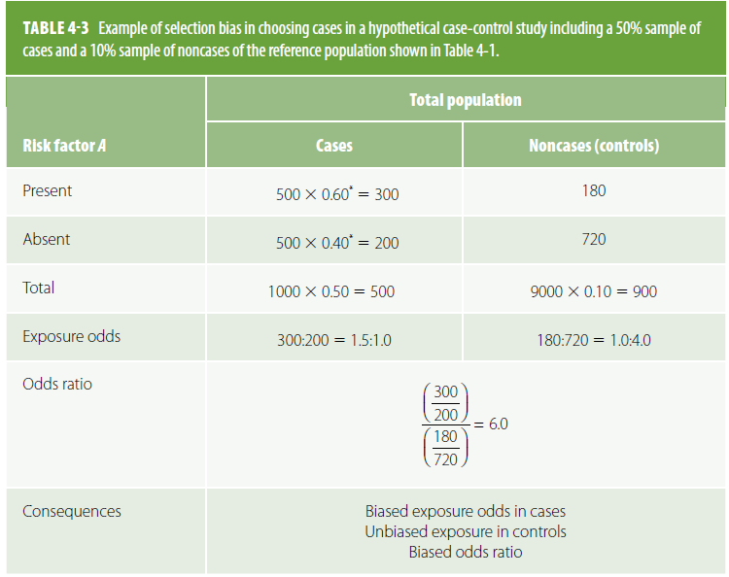

Slide 25
Compensating bias
Because differential bias of the type exemplified in Table 4-3 distorts the nature or magnitude of an association, investigators often attempt to "equalize" bias between the groups under comparison.
In retrospective studies, for example, attempts are often made to obtain samples of cases and controls undergoing the same selection processes.

Slide 26
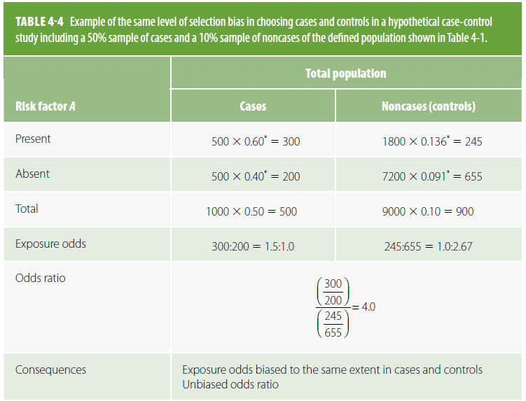
For compensating bias to occur, the same bias factor (in this example, "X 1.5") needs to be present in both the numerator and the denominator of the odds ratio so as to be canceled out:

Slide 27
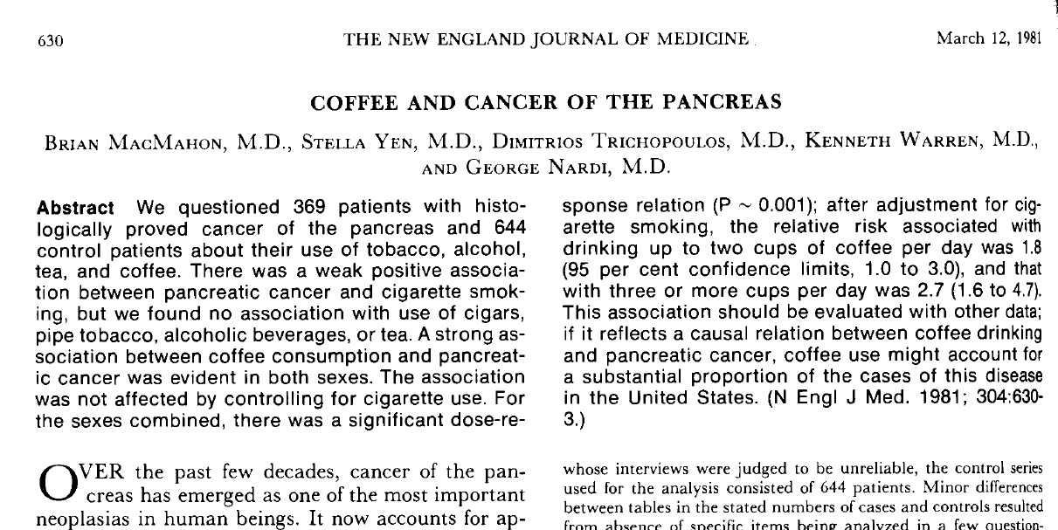

Slide 29
Selection bias in cohort
Healthy worker effect: In a cohort study, because study participants (exposed or unexposed) are selected before the disease actually occurs, differential selection according to disease status is less likely to occur. Nevertheless, selection bias may occur at the outset of a cohort study when, for example, a group of persons exposed to an occupational hazard is compared with a sample of the general population.
Differential losses to follow-up

Slide 30
Avoiding and detecting selection bias
In case-control studies, Choose controls from the same “study-base” as cases.
In cohort studies, the rate of loss to follow-up indicates the potential for selection bias. Comparison of the characteristics of those lost to follow-up with those persons remaining under follow-up, may indicate the potential consequences of any selection bias.

Slide 31
Information Bias
Information bias in epidemiologic studies results from either imperfect definitions of study variables or flawed data collection procedures. These errors may result in misclassification of exposure and/or outcome status for a significant proportion of study participants.
A classic example is: recall bias, in which the ability to recall past exposure is dependent on case or control status. Cases may be more likely than controls to overstate past exposure

Slide 32
Misclassification of EXPOSURE
REFERENCE
POPULATION
Diseased
The direction of the association is a function of which cell(s) are subjected to a higher or lower probability
+ -
+
-
Exposed
Cases Control
Eg...unexposed cases in this
example tend to mistakenly
report past exposure to a greater
extent than do controls
STUDY SAMPLE

Slide 33
Misclassification of OUTCOME
REFERENCE
POPULATION
Diseased
+ -
+
-
Exposed
Cases Control
Eg…cases in this are mistakenly classified as controls due to low sensitivity on a screening test
STUDY SAMPLE

Slide 34
Types of Information Biases
Exposure Identification Bias
Recall bias
Interviewer bias
Outcome Identification Bias
Observer bias
Respondent bias

Slide 35
Recall Bias
Most cited: inaccurate recall of past exposure (may be due to temporality, social desirability or diagnosis).
If recall differs between cases and controls, misclassification is differential;
If the error is of similar magnitude, then it is said to be non-differential
Notes:
In a case-control study nested in the Nurses' Health Study cohort, the authors assessed recall bias in the ascertainment of two risk factors for melanoma: hair color and ability to tart. Participants reported on these risk factors in a 1982 questionnaire and in a subsequent case-control questionnaire or telephone interview. The test-retest reliability among controls was high for both questions (Spearman's r = 0.76). Among women diagnosed with melanoma after the first questionnaire and before the second, there was a substantial shift toward reporting a reduced ability to tan when participants were questioned after the diagnosis of melanoma (p= 0.035). No shift was noted for the hair color question (p = 0.8). The authors conclude that recall bias was observed among female nurses with cutaneous melanoma in the assessment of tanning ability, a major risk factor for melanoma.

Slide 36
How to Prevent Recall Bias
Verification of exposure information from participants by review of pre-existing records.
Selection of diseased controls and compensating this bias.
Objective markers of exposure or susceptibility (for example- genetic markers).
Nested case-control studies allow evaluation of exposures prior to “case” status.

Slide 37
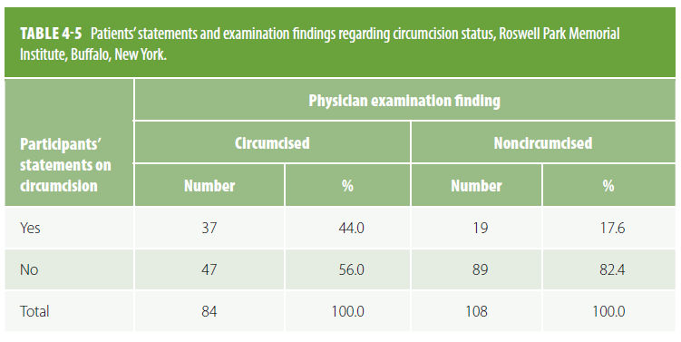

Slide 38
Interviewer Bias
May occur when interviewers are not blinded to disease status.
They may probe more
Interviewers may be biased toward the study hypothesis (or have other biases).
They may ignore protocols

Slide 39
Interviewer Bias
When data collection in a case-control study is not masked with regard to the disease status of study participants, observer bias in ascertaining exposure, such as interviewer bias, may occur.
Interviewer bias may be a consequence of trying to "clarify" questions when such clarifications are not part of the study protocol, failing to follow the protocol-determined probing, or skipping rules of questionnaires.

Slide 40
How to Prevent Interviewer Bias
Reliability and validity substudies in samples with quick feedback to interviewers who do not follow the protocol or who have encountered problems.
validity studies using independent sources (e.g., medical charts) can be conducted to assess accuracy of data collection by interviewers.
Masking of interviewers with regard to case-control status of study participants.

Slide 41
Outcome Identification Bias
may be due to an imperfect definition of the outcome or to errors at the data collection stage.
Two main examples:
Observer bias
Respondent bias
Notes:
1. Outcome identification bias when the ascertainment of outcome is not independent of knowledge of exposure status

Slide 42
Observer Bias
In a Cohort study: decision to classify outcome may be affected by knowledge of exposure status. Especially “soft” outcomes such as migraine, or psychiatric symptoms
Eg: assignment of diagnosis of hypertensive end-stage renal disease (ESRD). Nephrologists sent case histories were twice as likely to diagnose “black” patients with ESRD than “white” patients”.

Slide 43
Preventing Observer Bias
Masking observers in charge of deciding whether the outcome is present by exposure status.
stratifying on certainty of diagnosis.
Multiple observers

Slide 44
Respondent Bias
Synonym of recall bias in cohort studies.
outcome ascertainment bias may occur during follow-up of a cohort when information on the outcome is obtained by participant response: for example, when collecting information on events for which it is difficult to obtain objective confirmation, such as episodes of migraine headaches.

Slide 45
Respondent Bias
In a Cohort study: respondents may respond with little consistency to un-standardized questions or to “subjective” questions.
Eg. Questions about depression may be very subjective. A solution is to use a standardized instrument.

